Slide 1
Hemizero
Concept catalog

Slide 2
Topology overview
Possible topologies
Three-level
NPC
ANPC
SPB
MMC
T-type
Three-phase
Multi-phase
Conventional
Integrated battery
Flying capacitors
Two-level
Open-end windings

Slide 3
Comparison
Topology | No of semi-conductors | Semi-conductor rating | BV per semi-conductor | Harmonic impact at given fsw | Switched voltage | DC link capa-citance | # of isolated gate drivers
2L | 1 | 1 | 1 | 1 | 1 |  | 1
3L NPC | 2.5 | 1.25 | 0.5 | 0.25 | 0.5 |  | 2
3L ANPC | 3 | 1.5 | 0.5 | 0.25 | 0.5 |  | 3
3L T-type |  |  |  | ?

Slide 4
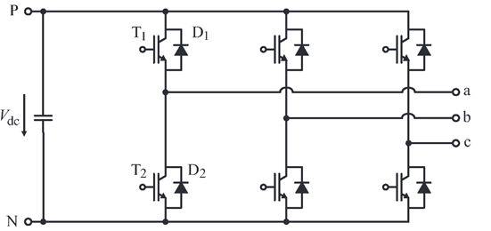
Two-Level VSI
Pros
Two-level inverters are less complex than the other topologies and have the least control effort.
Cons
A phase leg of a conventional two-level inverter consists of two transistors that block and switch the full dc-link voltage.
The connected machine suffers from higher harmonic losses and the steep voltage slopes can damage it by causing bearing currents or overstressing the winding insulation.
Two-level inverters have a bad efficiency for higher switching frequency.

Slide 5
Three-Level Neutral Point Clamped (3L-NPC) Inverter
Pros
Reduced Voltage Stress
  Switches block only half of the DC-link voltage, enabling use of lower-rated (cheaper) devices.
Lower Harmonic Distortion
  Additional voltage level reduces THD and machine losses compared to two-level inverters.
Improved Efficiency at Medium Frequencies
  More efficient than two-level inverters for switching frequencies 10–30 kHz.
Lower EMI
  Reduced dv/dt minimizes electromagnetic interference and motor insulation stress.
Cons
Higher Component Count
  Requires 4 switches + 2 diodes per leg, increasing complexity and cost.
Neutral Point Balancing
  Complex control needed to maintain capacitor voltage balance.
Unequal Loss Distribution
  Inner switches experience higher losses than outer switches.
Limited High-Frequency Efficiency
  Efficiency drops above 30 kHz due to switching losses.

Slide 6
Two-Level Inverters
Pros
Simple and Robust Structure :
  Uses only two switches per phase leg, making the circuit straightforward to implement.
  Fewer components reduce failure points and simplify maintenance.
Low Control Complexity
  Well-established PWM techniques (e.g.,sinusoidal PWM, space vector PWM) are easy to implement.
  Requires minimal computational effort compared to more advanced topologies.
Lower Cost
  Fewer semiconductor devices and passive components reduce manufacturing costs.
  Economical for low- and medium-power applications.
Compact Design
  Smaller footprint due to fewer components, making it suitable for space-constrained applications.
Mature Technology:
  Widely used in industry, with proven reliability in motor drives, UPS systems, and renewable energy applications.
Cons
High Voltage Stress on Switches:
  Each transistor must block the full DC-link voltage, requiring higher-rated (and more expensive) semiconductor devices.
High dv/dt and EMI Issues
  Fast switching generates steep voltage slopes, leading to electromagnetic interference (EMI) and requiring additional filters.
  Can cause insulation degradation in motors and transformers over time.
Harmonic Distortion and Machine Stress
  Produces higher total harmonic distortion (THD), increasing losses in connected machines (motors, generators).
  May cause bearing currents and winding insulation stress, reducing equipment lifespan.
Poor Efficiency at High Switching Frequencies
  Increased switching losses at higher frequencies reduce overall efficiency.
  Not ideal for applications requiring high-frequency operation.
Limited Voltage and Power Range
  Not suitable for very high-voltage applications without complex series connections of switches.
  Higher power levels lead to increased losses and thermal challenges.

Slide 7
Two-Level VSI
Pros
Two-level inverters are less complex than the other topologies and have the least control effort.
Cons
A phase leg of a conventional two-level inverter consists of two transistors that block and switch the full dc-link voltage.
The connected machine suffers from higher harmonic losses and the steep voltage slopes can damage it by causing bearing currents or overstressing the winding insulation.
Two-level inverters have a bad efficiency for higher switching frequency.

